Slide 1
Car Driving Using Hand Gesture Recognition
 | Presented By Mrinal Pramanik B.Tech, CSE SRM Institute of Science & Technology Ramapuram Campus, Chennai

Slide 2
Abstract
Gesture Recognition is a topic in computer science and language technology with the goal of interpreting human gestures via mathematical algorithms.
Our project ‘Car driving using Hand Gesture Recognition’ is the implementation of Artificial Intelligence into automobile engineering.
This project works on a trained neural network comparing gestures on basis of already fed gesture data.

Slide 3
LITERATURE SURVEY
S.NO. | TITLE | CONCEPT | ALGORITHM | DRAWBACK
1. | A Research Study of Hand Gesture Recognition Technologies and Applications for Human Vehicle Interaction | This paper describes the primary and secondary driving task together with Human Machine Interface (HMI) trends and issues which are driving automotive user interface designers to consider hand gesture recognition as a realistic alternative for user controls | The Canny Edge Detection Algorithm. | The concept of selective themes of pre-emptive gestures, function associated gestures, context sensitive gestures, concepts are being further developed.

Slide 4
S.NO. | TITLE | CONCEPT | ALGORITHM | DRAWBACK
2. | Hand Gestures to Control Infotainment Equipment in Cars. (ResearchGate-2018) | A complete system for controlling the infotainment equipment through hand gestures is explained in this paper. The system works with a visible-infrared camera mounted on the ceiling of the car and pointing to the shift-stick area, and is based in a combination of some new and some well- known computer vision algorithms. The system has been tested by 23 volunteers on a car simulator and a real vehicle and the results show that the users slightly prefer this system to an equivalent one based on a touch-screen interface. | The core of the system is composed by the computer- vision algorithms, that process the input video stream, detecting, segmenting, tracking, classifying and coding the hand gesture to feed the interface manager. | There is still some work to do to improve reliability, at least enough to surpass the touch-screen based interface.

Slide 5
S.NO. | TITLE | CONCEPT | ALGORITHM | DRAWBACK
3. | GLADAS: Gesture Learning for Advanced Driver Assistance Systems. (Harvard-edge-2019) | In this paper, we present GLADAS, a simulator-based research platform designed to teach AVs to understand pedestrian hand gestures. GLADAS supports the training, testing, and validation of deep learning-based self-driving car ges- ture recognition systems. We focus on gestures as they are a primordial (i.e, natural and common) way to interact with cars. To the best of our knowledge, GLADAS is the first system of its kind designed to provide an infrastruc- ture for further research into human-AV interaction. | real-time gesture recognition algorithm | The results provided by the simulator suggest a need for continued gesture learning research as well as the necessity of developing benchmarking and safety tests for self- driving cars, particularly within the context of gesture learning.

Slide 6
S.NO. | TITLE | CONCEPT | ALGORITHM | DRAWBACK
4. | Real Time Hand Gesture Recognition System (tagajournal-2018) | In this paper, automatic detection and classifications of hand sign language recognition system is proposed. It consists of preprocessing, transformation, feature extraction and classifications. The RGB image is converted into grey scale image as a preprocessing method and then this image is converted into multi resolution image using Gabor transform. Then, features are extracted from Gabor transformed image and these features are classified using Adaptive Neuro Fuzzy Inference System (ANFIS) classifier. | Gabor transforms is used in this paper which performs multi resolution process with out using sub bands. | The proposed methodology stated in this paper achives 90% of sensitivity, 95% of specificity, 92% of accuracy and 90% of classification rate.

Slide 7
S.NO. | TITLE | CONCEPT | ALGORITHM | DRAWBACK
5. | Designing an Advanced Drivers Assistance System Based on Emotion and Gesture Recognition using Soft Computing Techniques (socialresearchfoundation-2017) | The objective of this paper to design a system in which due to less attention on driving due to any reasons ,vehicle will automatically switch to automatic mode and novel fuzzy system created based on number of rules define through the analysis of various condition and expression also detect facial gesture through the eyes motion and lips. This paper classifying specifies emotions of human like anger,sad,surprise and based on classifies emotions, shifted to automatic designed mode of vehicle. | Systems implemented:-FERS (Facial Expression Recognition System), Human Centered Transportation System (HCTS), FBS (Fuzzy Rule Based System), ADAS (Advance Driver Assistance System) | The framework gives 91.66% Accuracy for Facial Gesture Tracking and 90% Accuracy for Emotions acknowledgment while utilizing Simultaneous Facial Gesture Tracking and Emotion acknowledgment it gives 94.58% precision.

Slide 8
S.NO. | TITLE | CONCEPT | ALGORITHM | DRAWBACK
6. | Gesture Recognition: A Survey (IEEE-2017) | In this paper, we provide a survey on gesture recognition with particular emphasis on hand gestures and facial expressions. Applications involving hidden Markov models, particle filtering and condensation, finite-state machines, optical flow, skin color, and connectionist models are discussed in detail. | Particle Filtering and Condensation Algorithm | Not all facial expressions can be completely classified into the six defined categories. In, this model, there is no possibility of learning new categories for clustering, and then interpreting each and every encountered facial expression.

Slide 9
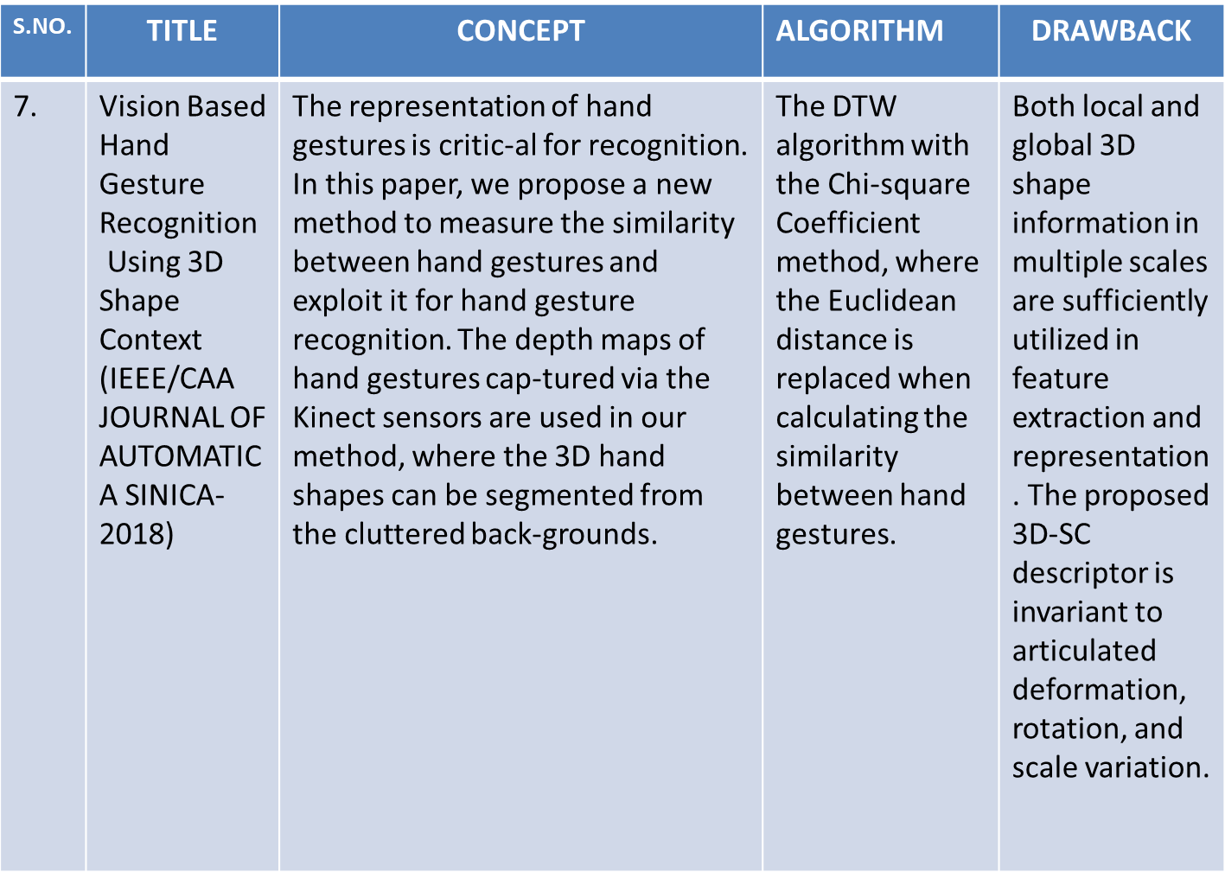

Slide 10
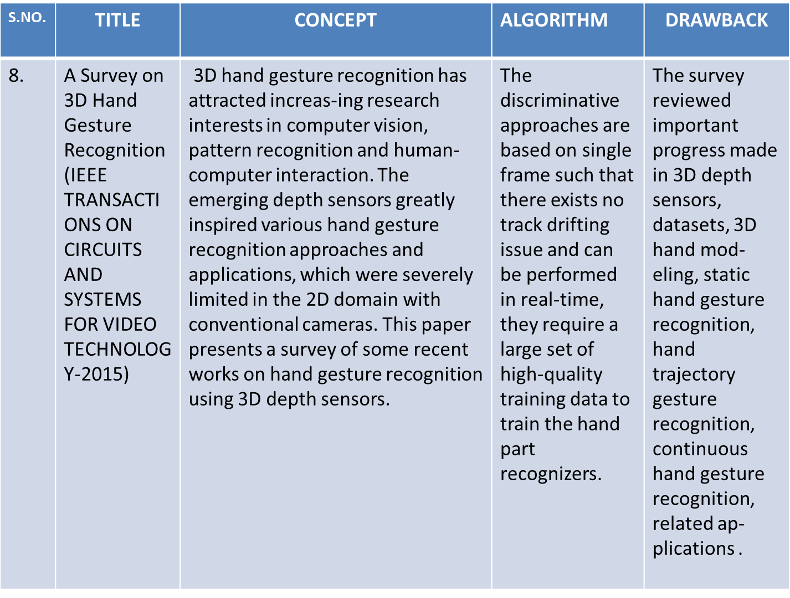

Slide 11
Existing System Drawbacks
Manual driving takes time and patience to learn and initially might be dangerous as well.
The reflexives during emergency conditions might be improper in case of manual driving.
Continuous usage of clutch in long journeys can be a physical strain to the driver.

Slide 12
Introduction to proposed model
In the proposed model, we implemented the concept of neural networks with general driving hand gestures to produce a smart self driven car driving system.
This model is a software implementation of the mentioned concept.
The gesture recognition is done with the help of openCV library file in python which assists in capturing videos and images.

Slide 13
Problem Statement
Below data is given by World Health Organisation (WHO)—
Approx. 1.35 million deaths are recorded in car crashes.
Road crashes cost 3% of any country’s GDP
Road traffic injuries causes death for children and youth between 5-29 years.
93% of fatalities occur in low and middle income countries.
On basis of above data and surveys people with low socio-economic status as well as children/young adults are victims.
Data also shows the fact that 73% of crashes involve male drivers under age of 25 years.

Slide 14
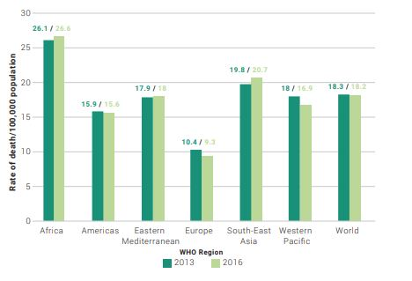
Rates of Road Traffic Death per 1,00,000 population by WHO regions : 2013,16

Slide 15
Risk Factors
Speeding
Driving under the influence of alcohol and other psychoactive substances
Distracted driving
Unsafe vehicles
Inadequate post-crash care
Inadequate law enforcement of traffic laws

Slide 16
Proposed model
The proposed model working is on basis of concepts of Neural Networks in Deep learning.
The designed neural network has already been fed with some prefixed general hand gestures used while driving.
The recognition of hand gesture can be divided into 4 phases/modules namely---
Hand Detection phase
Fingers and palm detection phase
Fingers/Finger Curves recognition phase
Hand Gesture recognition phase

Slide 17
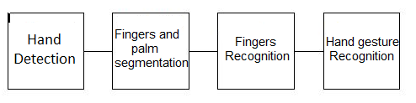
Overview of the Phases of proposed model

Slide 18
A. Hand Detection Phase
The Hand detection phase concerns with identification of the hand region in the input captured image/video.
In this phase, we separate out the hand region from the background depending on the type of background and objects present in the background.
When background is uniform we use subtraction method to cut out hand region.
When some other object is detected the skin colour is taken as parameter to detect the hand region.

Slide 19
B. Fingers and Palm Detection Phase
This phase is further divided into 5 phases—
a) Palm point detection
b) Inner circle of Maximal Radius
c) Wrist Point and Palm Mask
d)Hand Rotation
e) Fingers and Palm Segmentation

Slide 20
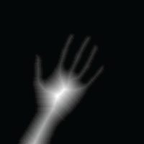
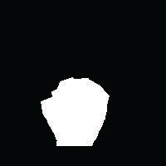
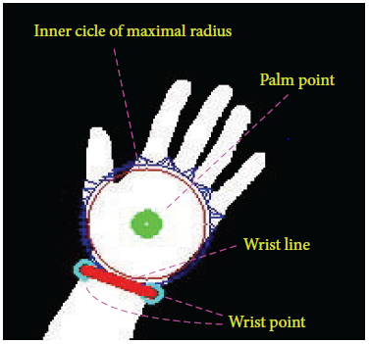
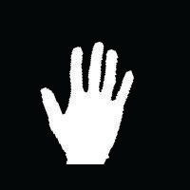
The distance transform of the hand image
The palm mask
The palm point, wrist points, the wrist line, and the inner
circle of the maximal radius
The rotated and cut hand image.

Slide 21
C. Fingers Recognition
This phase concerns with the recognition of finger regions.
It includes two further steps—
a) Thumb Detection and Recognition
b) Detection and Recognition of other fingers

Slide 22
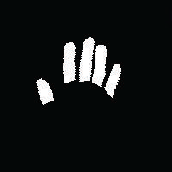
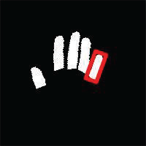
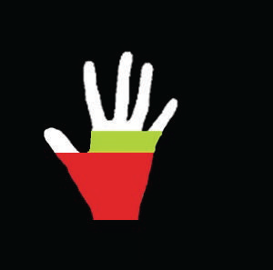
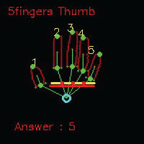
The segmented fingers
The minimal bounding box.
The palm line
The recognition of the fingers

Slide 23
D. Final Hand Gesture Recognition Phase
This Final Phase deals with the final comparison of the of the recognized hand gesture with the already present data in the network.
The gesture is identified and the action is performed accordingly.

Slide 24
Applied Algorithm
Input: A Group of points sampled uniformly from the circle
From the sample point find the nearest boundary point (M,N) (refer to (1))
Step 1. Get a pixel (m, n) around the sample point (M, N)
m = cos (angle ∗ 𝜋/180) ∗ rad+M
n = sin (angle ∗ 𝜋/180) ∗ rad + N
angle 𝜖 [0, 360] and rad 𝜖 [1,S] (S is the image size)
Step 2. If the value of the pixel is 0 i.e. 𝑃(m, n) == 0,
goto Step 3. Otherwise, increase rad and angle with a step of 1 and then go to Step 1

Slide 25
Step 3. Check for the values of 8 neighbors of the pixel (m, n), if it holds
∀𝑃(m + 𝑑m, n + 𝑑n) == 0, (m + 𝑑m, n + 𝑑n) ∈ Q(m,n)
𝑁(m,n) is the set of 8 neighbors of the pixel (m, n).
Insert the point (m + 𝑑m, n + 𝑑n) into the array of palm mask points.
Step 4. Increase rad and angle, and then goto Step 1
(i) Continue to search the nearest boundary point of another sampled point until all
the sampled points are scanned.
(ii) Connect all the points recorded in the array of palm mask points to yield the palm mask.

Slide 26
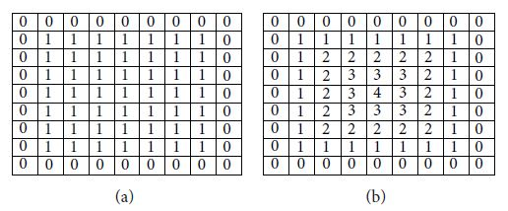
(a) is a binary image
(b) is a distance transform
Fig: An example of distance transform

Slide 27
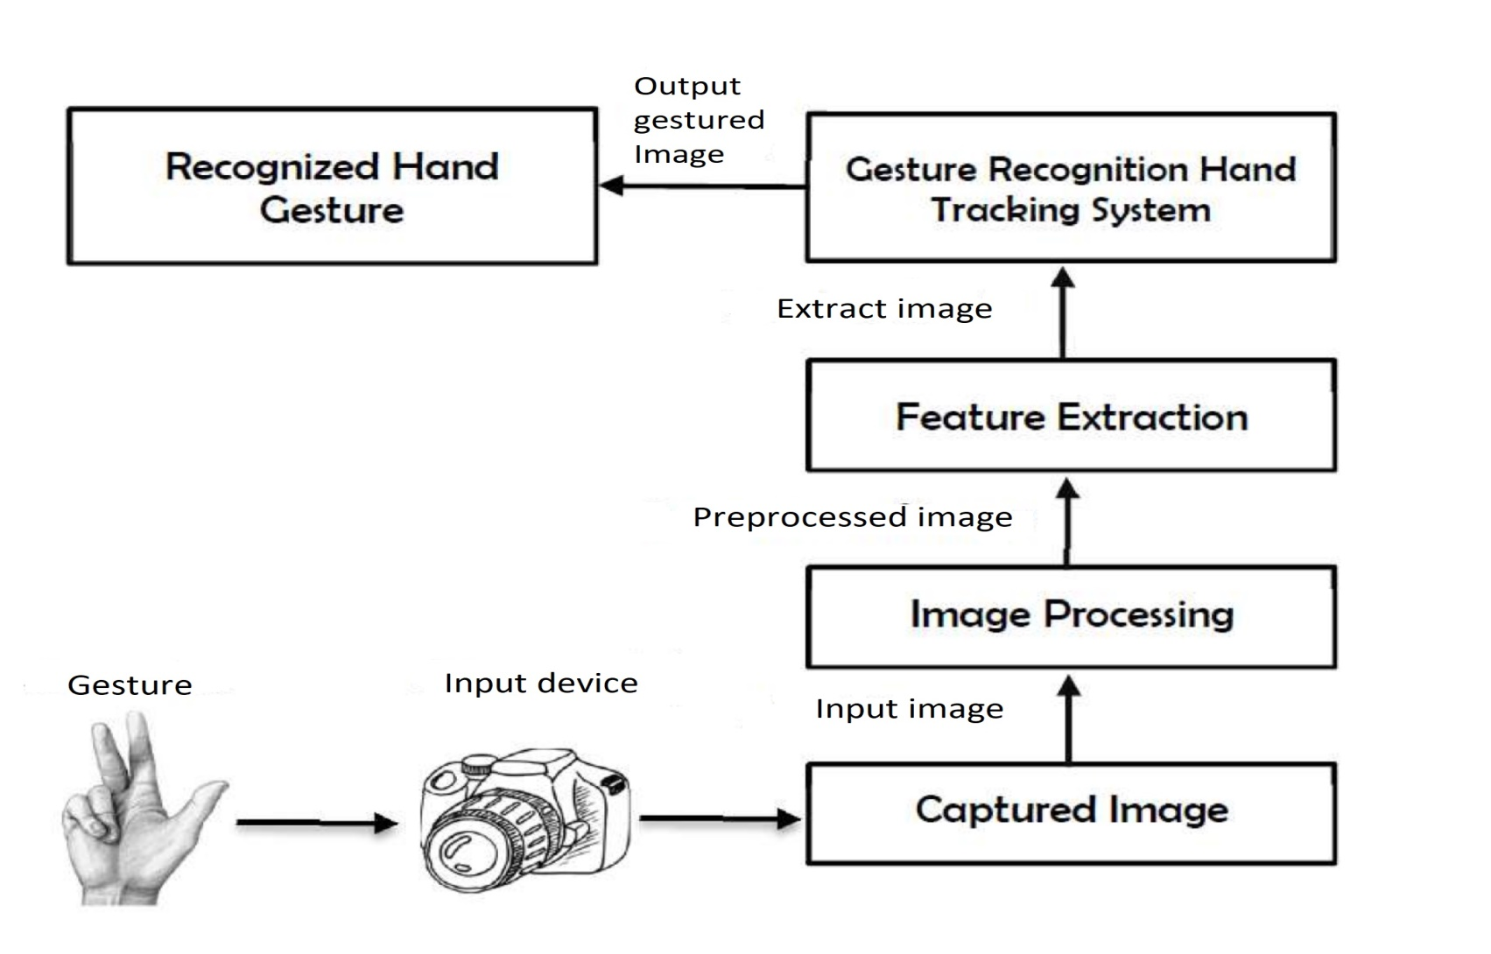
System Architecture

Slide 28
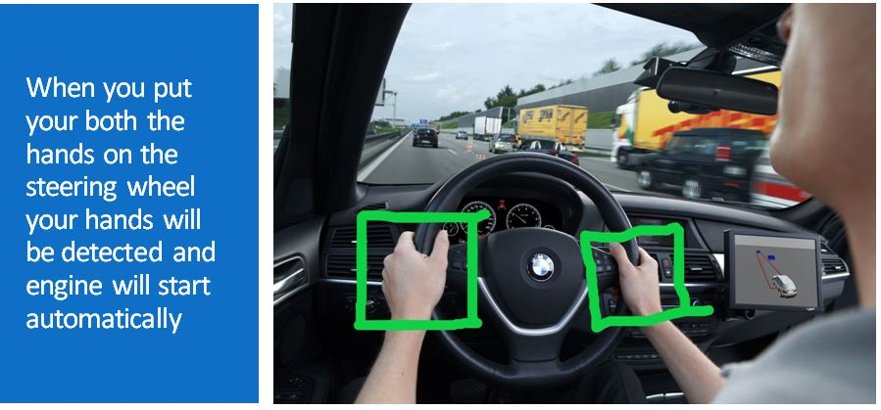
Implementation

Slide 29
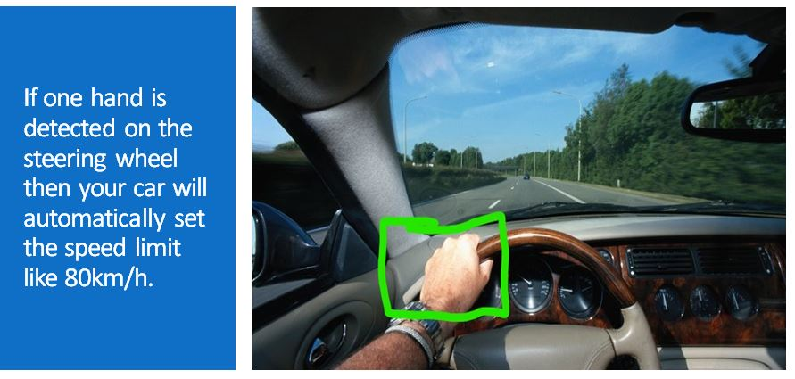

Slide 30
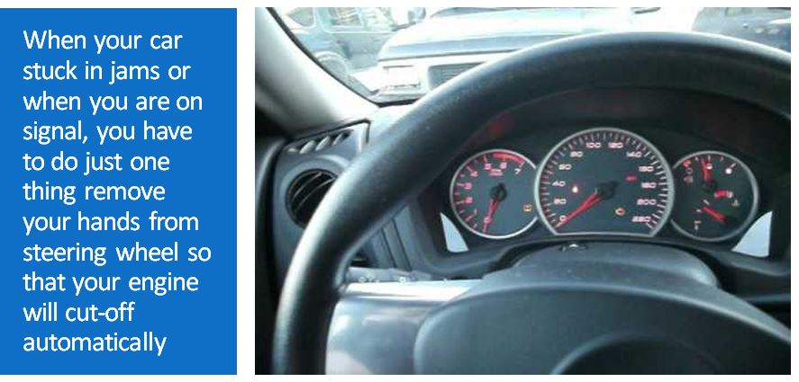

Slide 31
Advantages of proposed model
The proposed model is a way nice solution to the drivers of long journey as it reduces risk of physical strain in ankle and lower foot region.
The model can also help in executing sudden and reflex actions during emergency conditions.
Driving becomes easy as driver has to only handle the grip on his steering instead of minding the accelerator or clutch during whole journey.

Slide 32
Future Scope and Work
The proposed model is implemented assuming that the background of driver remains uninterrupted by other objects which might create ambiguity in detection of hand region.
If some other object (or hand-like object) comes in background then it decreases the efficiency and might result in improper results.
For future work, we can find some technology or concept that can overcome this possibility of inefficiency.

Slide 33
Conclusion
The model is uses concept of Deep learning’s Neural network to detect the hand gesture and apply procedures accordingly.
In this model, firstly, video gets captured and parts of hand region are detected using segmentation process to differentiate the palm and fingers.
Then the fingers are detected and gesture is recognized with the help of Classifier which holds data set of all gestures.
Experimentation and testing shows that the model is working correctly and can be implemented.

